Slide 1



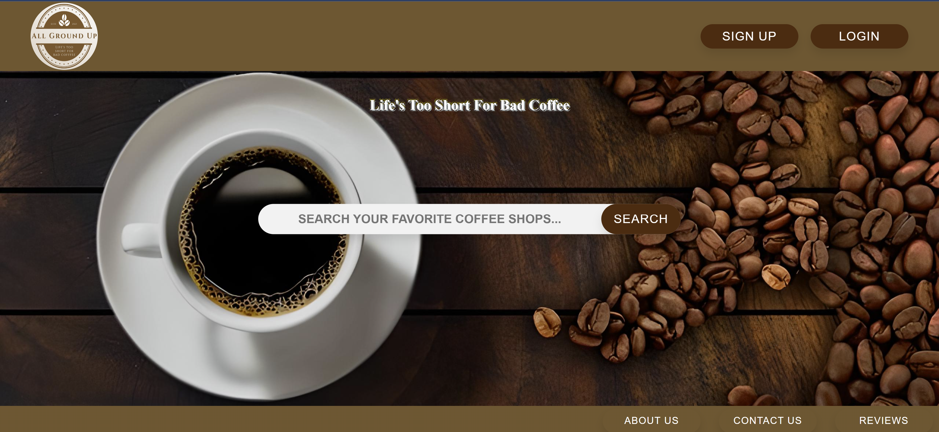
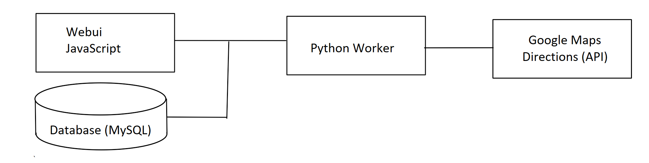
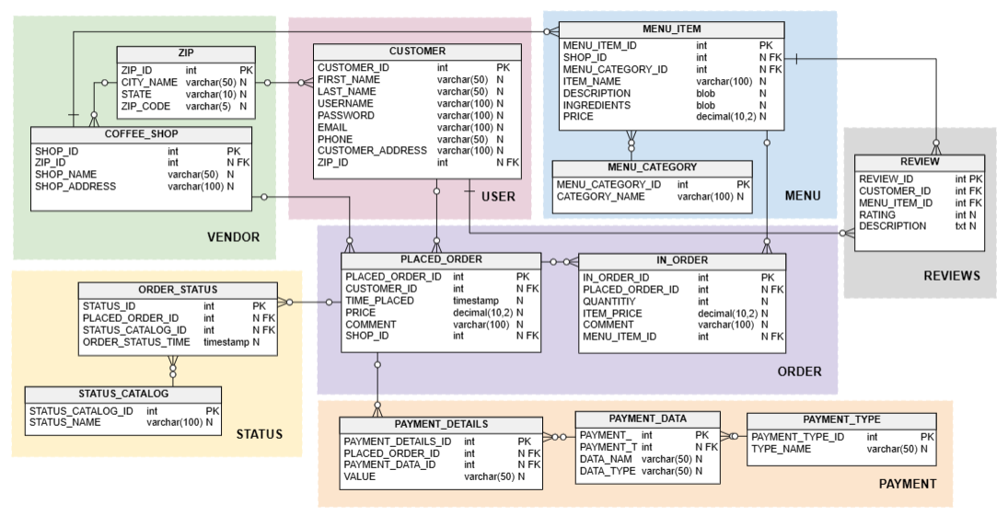
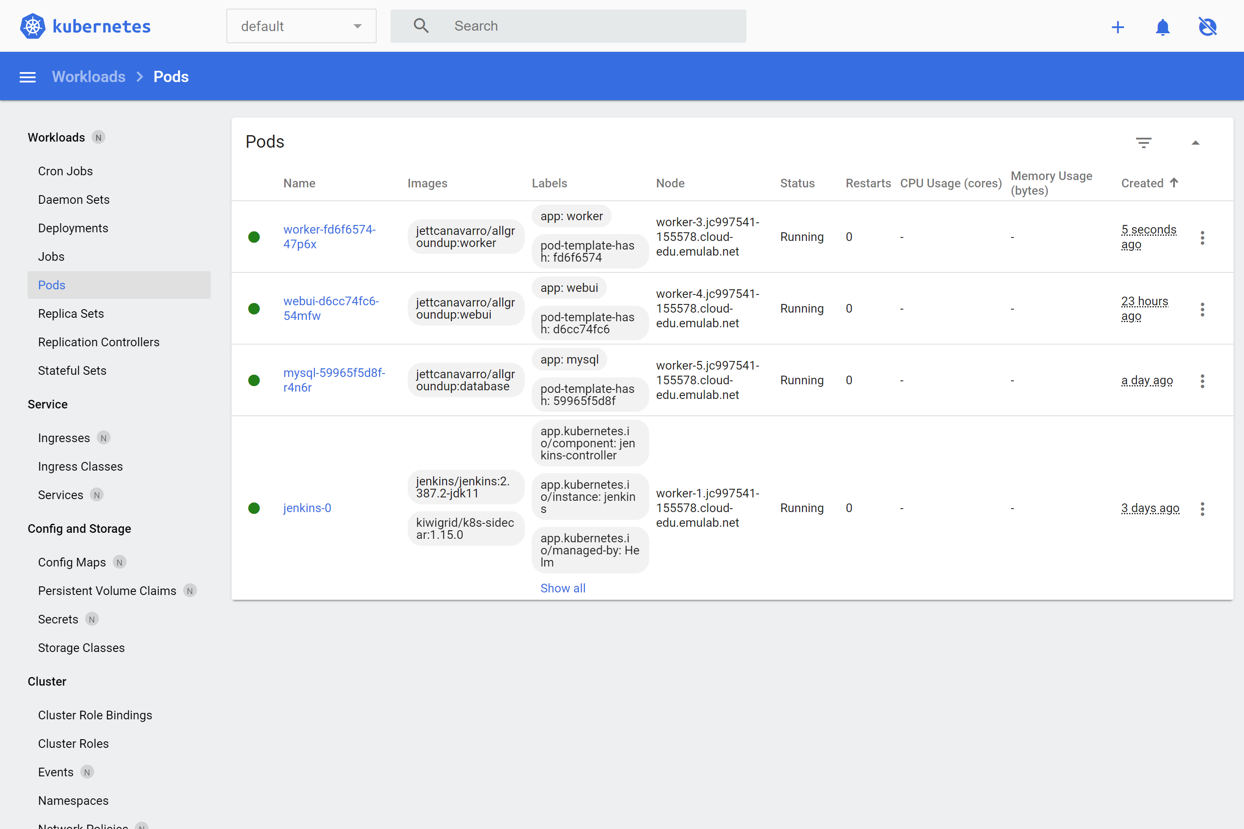





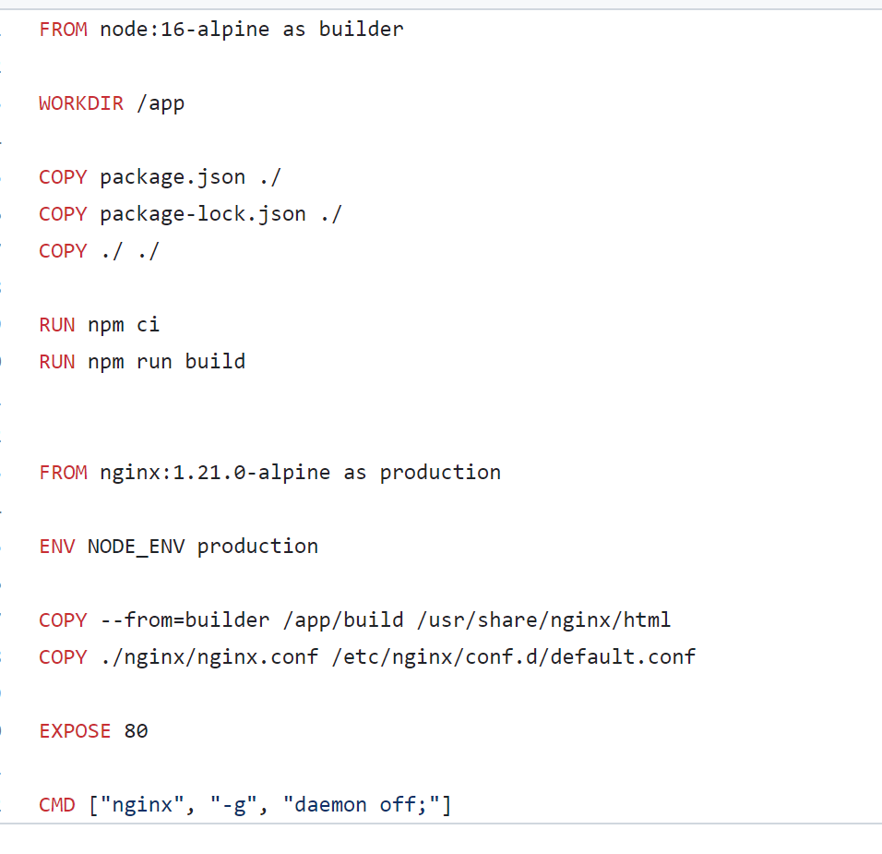
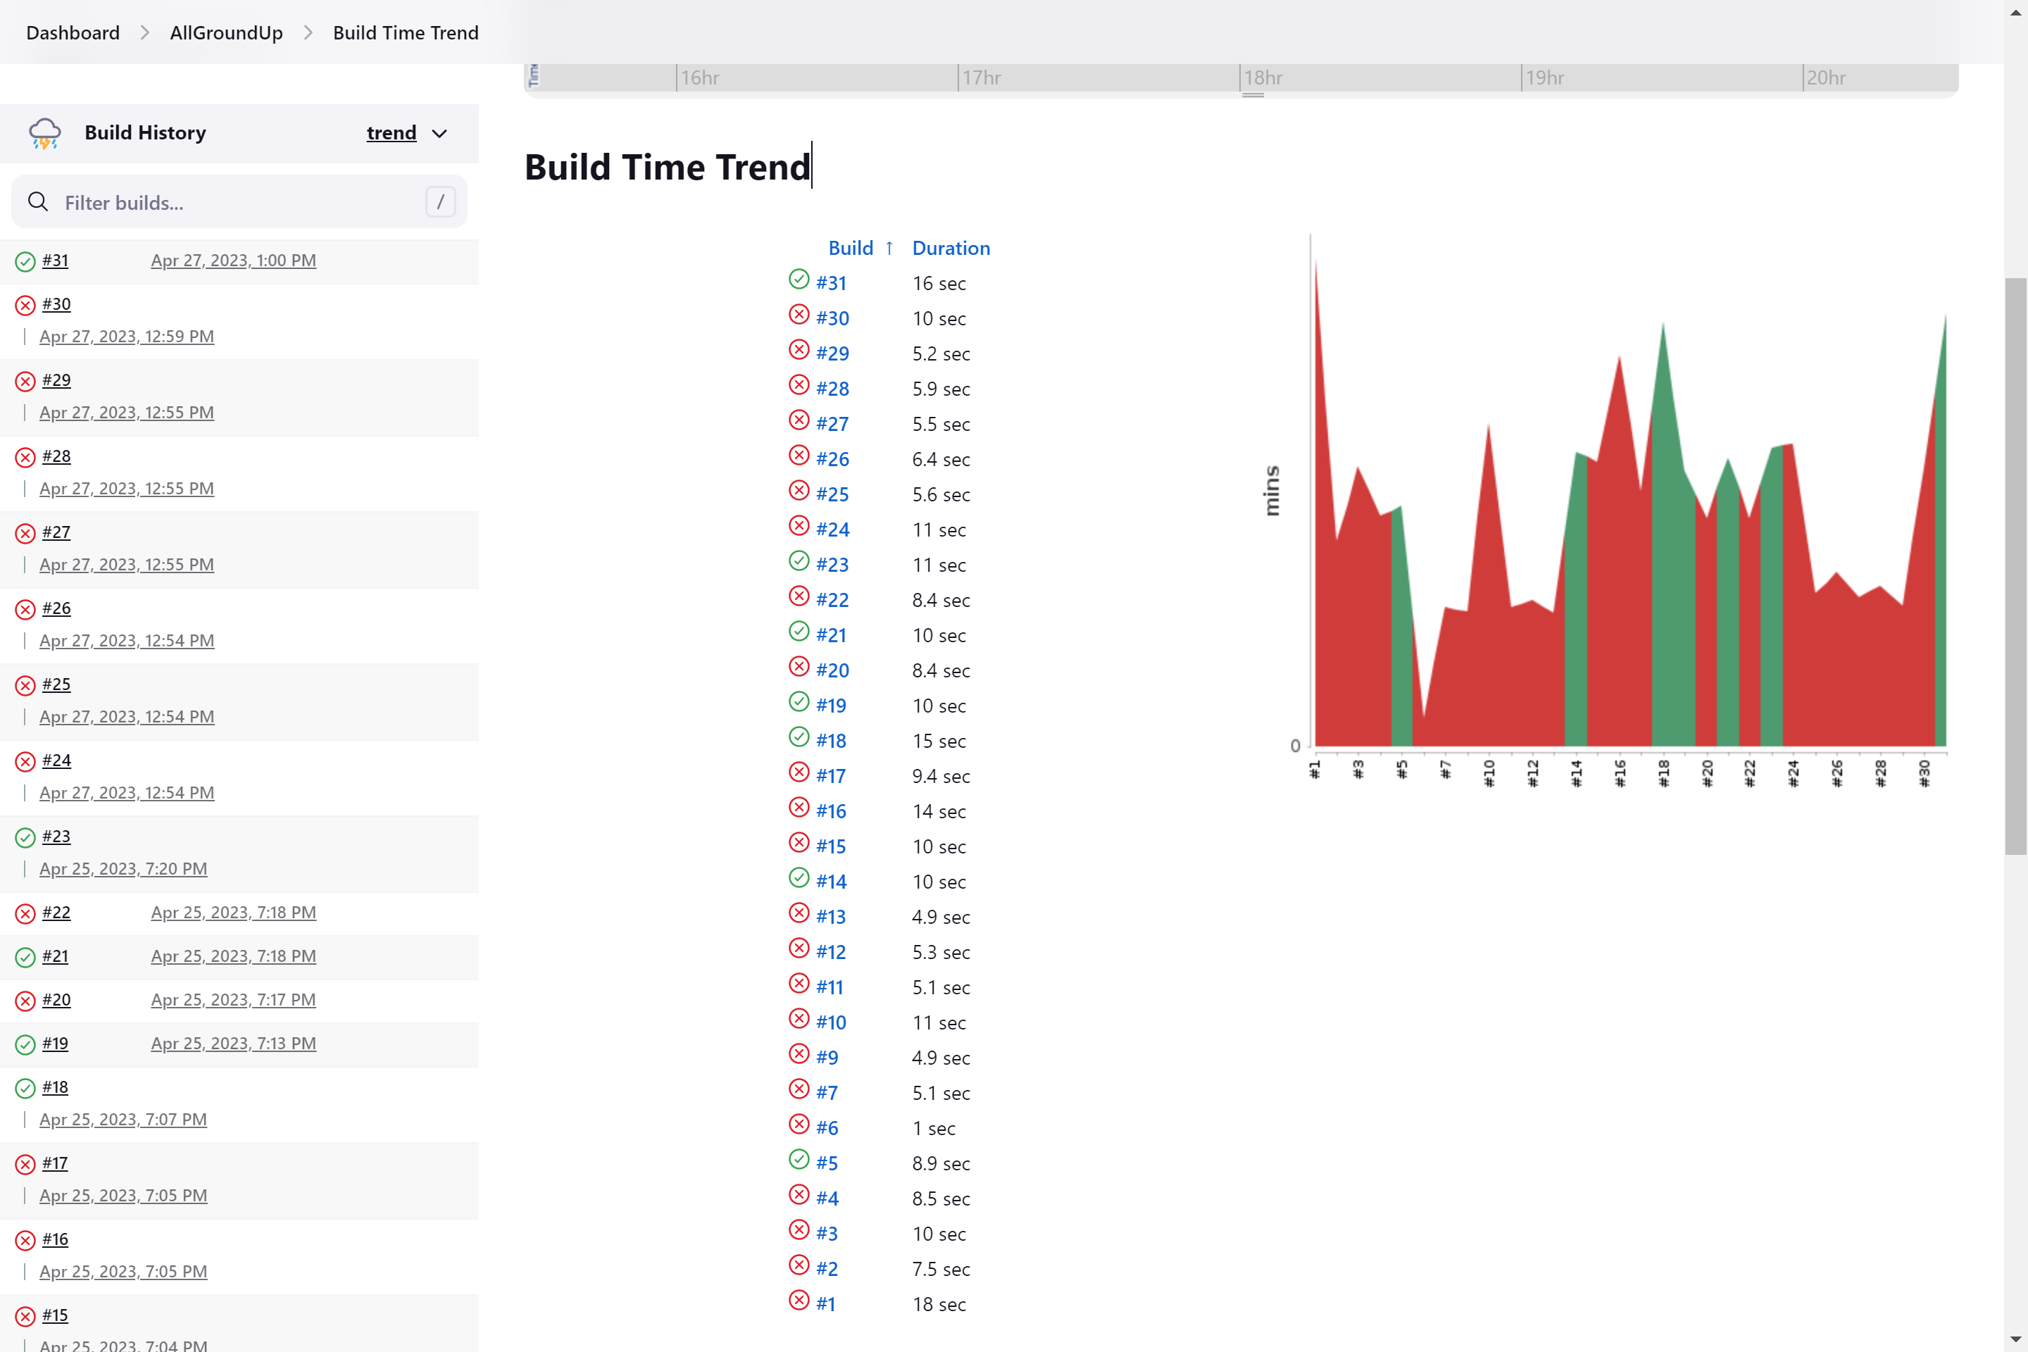
All Ground Up
Mateen Ali, Alejandro Almaraz, Jessica Arriaga,
Jett Canavarro, Steven Coffey​
Project Overview
All Ground Up is a cloud-based web application designed to allow users to review and order-in from their favorite local coffee shops with ease. The application connects customers to local coffee shops with a review driven design. The customers can order from the application and the order will be ready for pick up. Vendors can change and update their menu which will be updated directly for the customers to view.
Architecture
Database Design
The chart demonstrates how the different components of the project play a role in the structure of our cloud-based application. Front-end works with the web UI which uses React.js. React.js is a JavaScript development framework used for the creation of web applications. Back-end works with the Python worker and the MySQL database.
The database management system chosen is MySQL which works well with the size of our application.
Docker and Cloud Deployment
CI/CD Services
Using the CI/CD pipeline above, we implemented a continuous integration and deployment pipeline to deliver a new version of the cloud-based application. This helped to increase the development of the application by automating the software delivery while it is being built.
Web UI Dockerfile
There are three individual Docker images with a backend image for Python, MYSQL image to store data and a front-end image to the run the React app. The three images were built, deployed, and managed with the Kubernetes orchestration system.

